Slide 1



Comilla University
GROUP 2

Slide 2
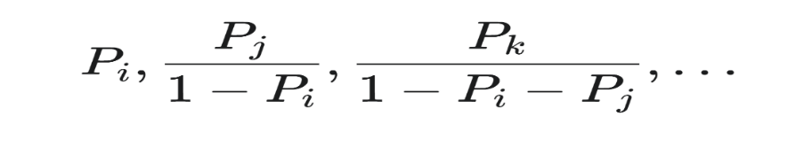
ID-12113002
Murthy's Method: Uncorrelated Sampling
Murthy's Innovation: Unordering the Sample
The method follows earlier work by Raj, which used an ordered selection process
Murthy's Key Insight: He showed that for any ordered sample, it's possible to obtain an unordered estimate.
This unordered estimate is unbiased and has a smaller variance than the ordered estimate
Selection Probabilities (Sequential Draws)
The probabilities of selecting successive clusters i, j, k are:

Slide 3
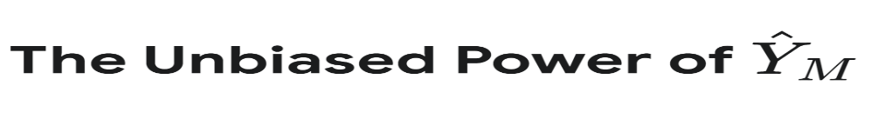
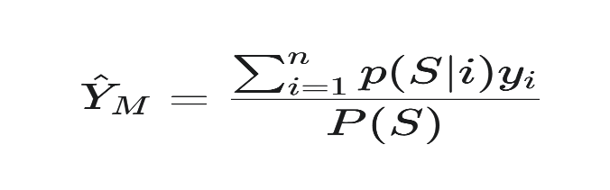
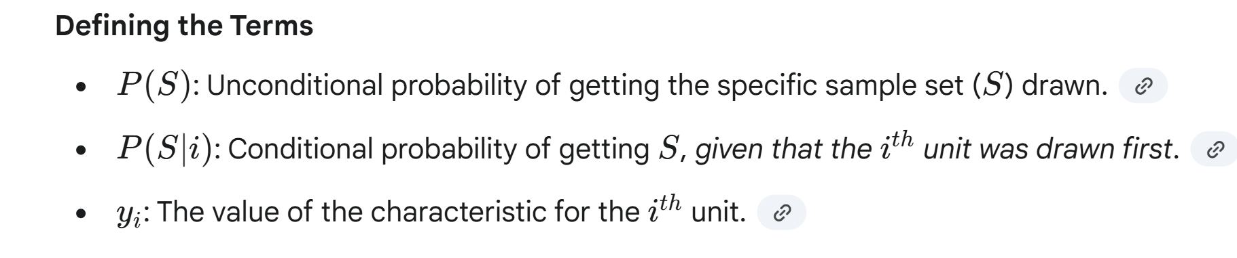
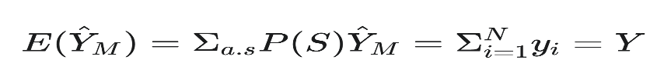
Murthy's Unbiased Estimator for Population Total (Y)
The core formula relies on conditional probability:
The Unbiased Proof
The estimator is guaranteed to be unbiased, meaning its expected value equals the true total:

Slide 4
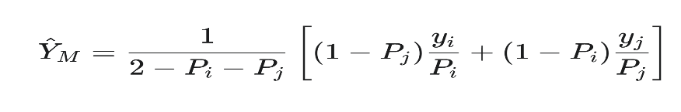
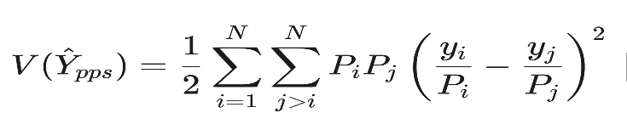
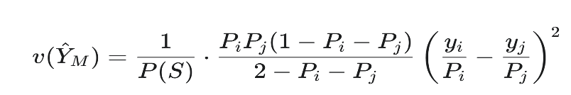
Deconstructing the Variance
The n=2 Estimator
For a small sample (n=2 units i and j), the formula becomes:
The Variance Formula(n=2)
The variance is expressed as a weighted sum of the squared difference of the ratio estimates:
Unbiased Variance Estimate
An unbiased and always positive estimate of this variance is available for practical use:

Slide 5
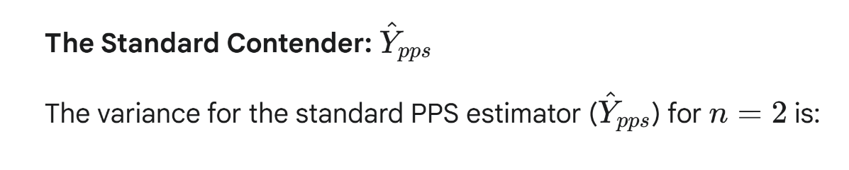
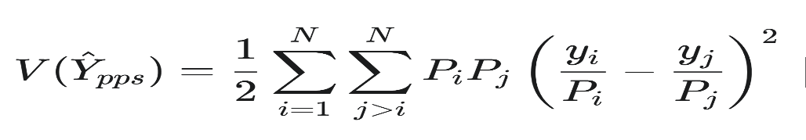
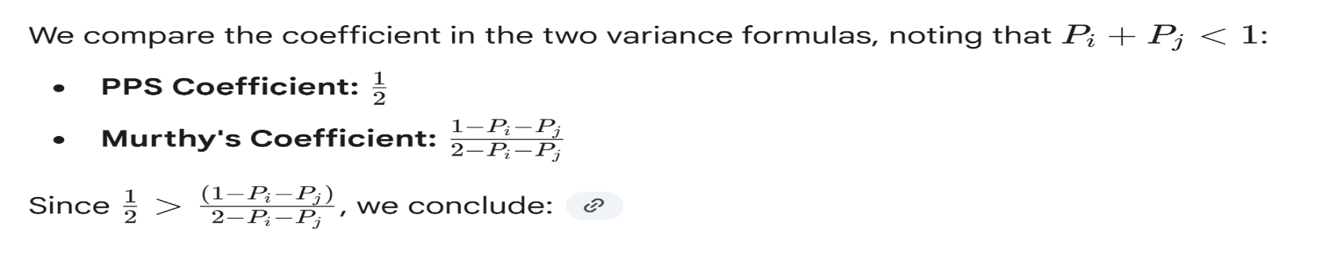
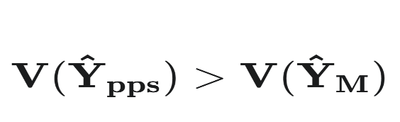
Murthy's Efficiency Edge over PPS
The Critical Comparison (Coefficients)
The Result: Murthy Wins on Variance!
Murthy's estimator is more efficient than the standard UPSWOR estimator:

Slide 6
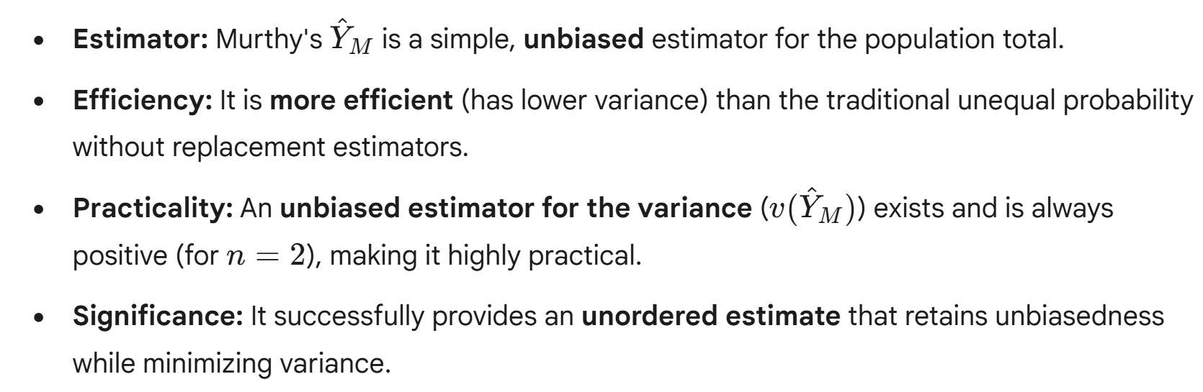
Summary and Significance

Slide 7

ID-12113010
Unveiling the Unseen: The Rao, Hartley, and Cochran Random Method
Notes:
1

Slide 8
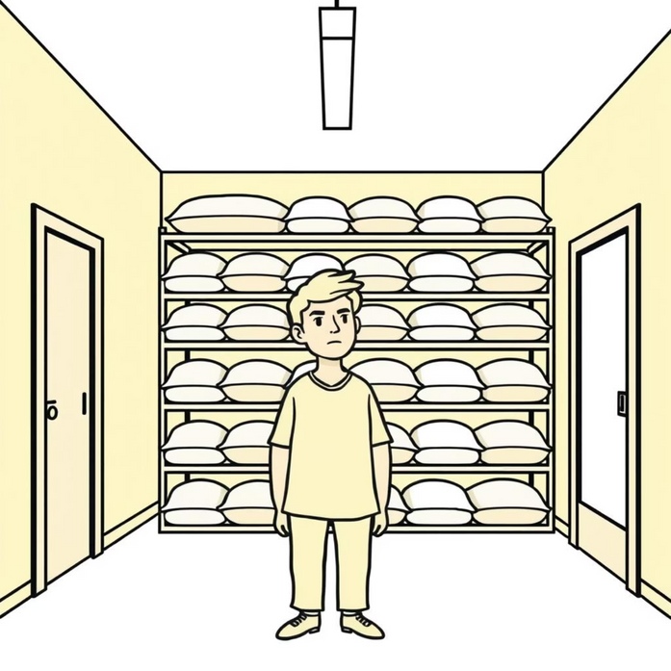

Counting Rice During Covid Quarantine
An RHC Method Adventure in Home Sampling
Notes:
2

Slide 9



The Architects of Chance
C.R. Rao
W.G. Cochran
A giant in theoretical statistics known for significant contributions to multivariate analysis and estimation theory.
Authored influential texts on experimental design and sampling techniques, focusing on practical applicability in research.
1
2
3
H.O. Hartley
Pioneered techniques in sampling theory and statistical computing, particularly variance estimation methods.
Notes:
3

Slide 10



Enter the Rao-Hartley-Cochran Method
RHC Sampling: The smart, rigorous way to divide the population to select a proportional sample.
Divide
Select
Estimate
Split the population into smaller, random groups (sub-samples).
Choose exactly one unit from each random group.
Use the selected units to form an unbiased overall estimate.
Notes:
4

Slide 11
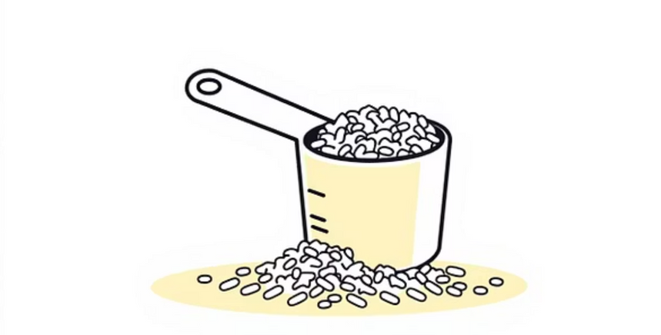
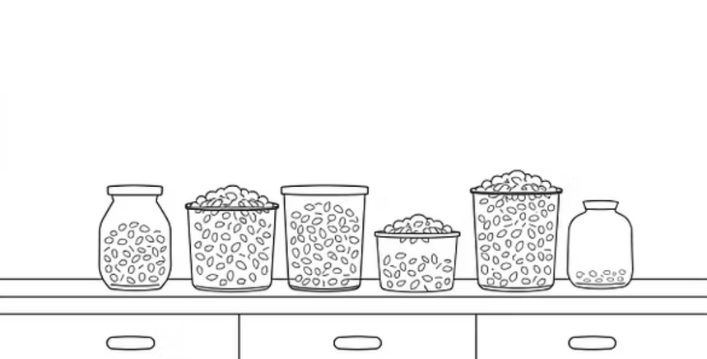

Setting Up the Rice Experiment
Define Population
Create Subsamples
All rice grains in the pantry (approx. 5 kg).
Randomly draw small, weighted subsamples from each bag.
Establish Frame
Measure & Count
Divide total rice into manageable, equal-sized bags.
Precisely count grains in the selected subsamples.
Notes:
5

Slide 12

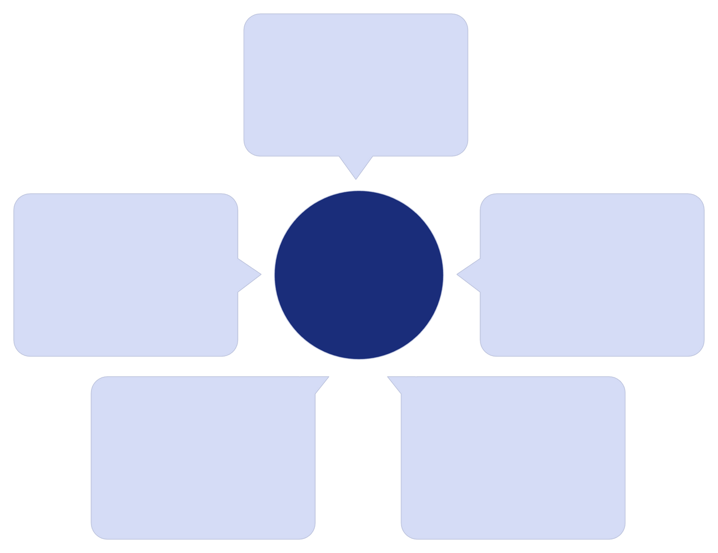
How RHC Works
Group 1
1225g Rice
Fair Sample (N=4)
5kg rice grains
Group 2
1225g Rice
One from each group
Group 4
Group 3
1225g Rice
1225g Rice
Notes:
7

Slide 13
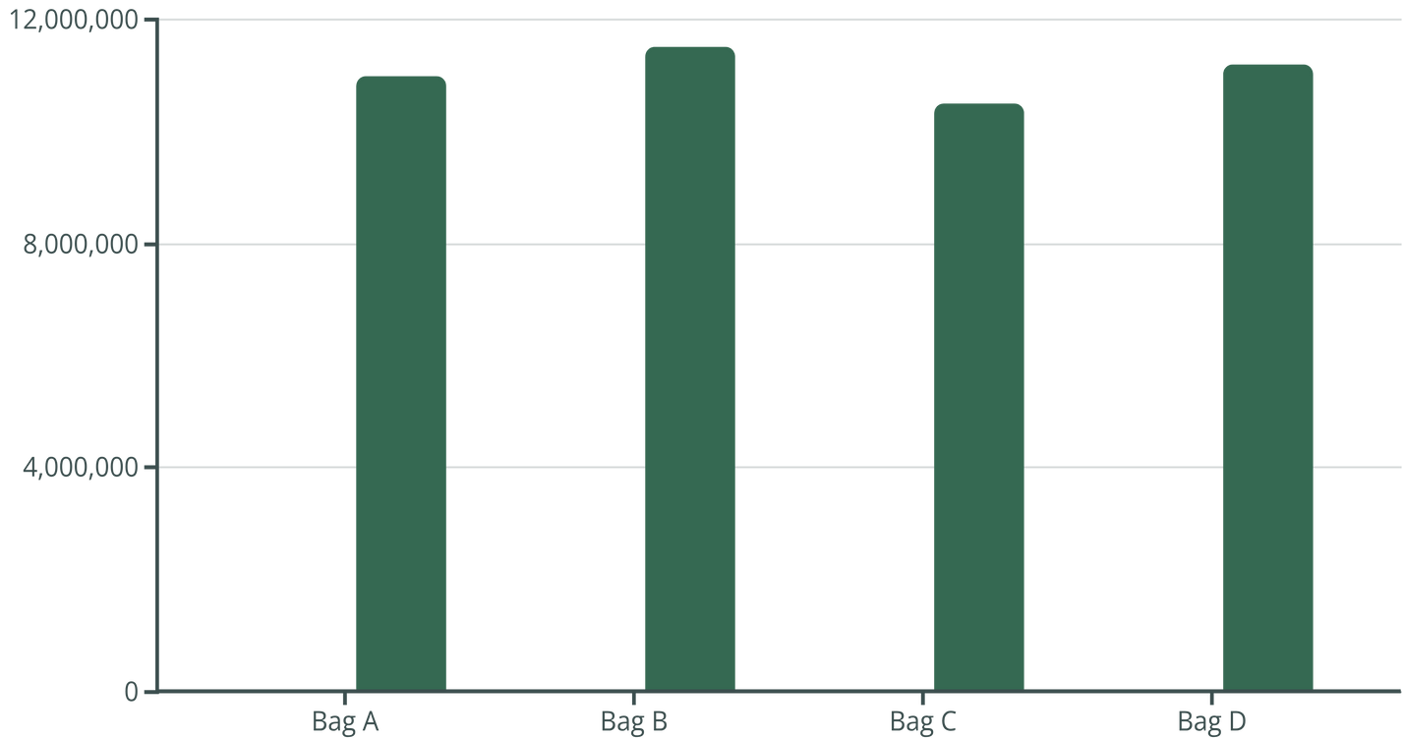
Visualizing the Data
Estimating the Grand Total
Sample Count (Grains/g)
Total Estimated Grains
Final Estimate: 44.2 Million Grains (with a 95% confidence interval of +/- 50,000 grains).
Notes:
8

Slide 14
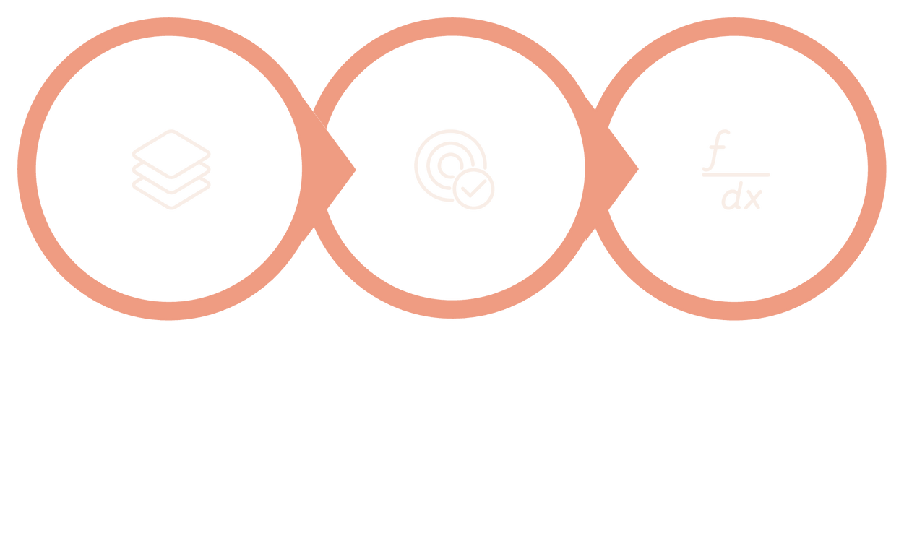
From Chaos to Clarity: How the Method Works
The RHC method is a sophisticated approach to Probability Proportional to Size (PPS) sampling, dividing a population into non-overlapping groups before selecting samples.
Estimate
Partition
PPS Select
Notes:
9

Slide 15

Assumptions
1
2
Stratification: Dividing the population into non-overlapping groups (the bags of rice).
Proportional Allocation: Ensuring sample size reflects the size of each stratum.
3
Unbiased Estimation: Using the RHC estimator formula to calculate the total count.
"RHC offers low variance and near-perfect balance, even with simple randomization."
Notes:
6

Slide 16
Summaries the formulas
The power of the Rao, Hartley, and Cochran method lies in its elegant mathematical foundation, specifically in the variance formula, which simplifies estimation.
RHC Estimator for the Population Total (Y)
Where $y_i$ is the value of the characteristic for the unit sampled from group $i$, and $p_i$ is the probability of selecting that unit within its group.
RHC Variance Estimator
This variance expression is exact and often lower than the variance provided by standard Simple Random Sampling without replacement (SRSWOR), demonstrating RHC's superior efficiency in PPS scenarios.
Notes:
10

Slide 17
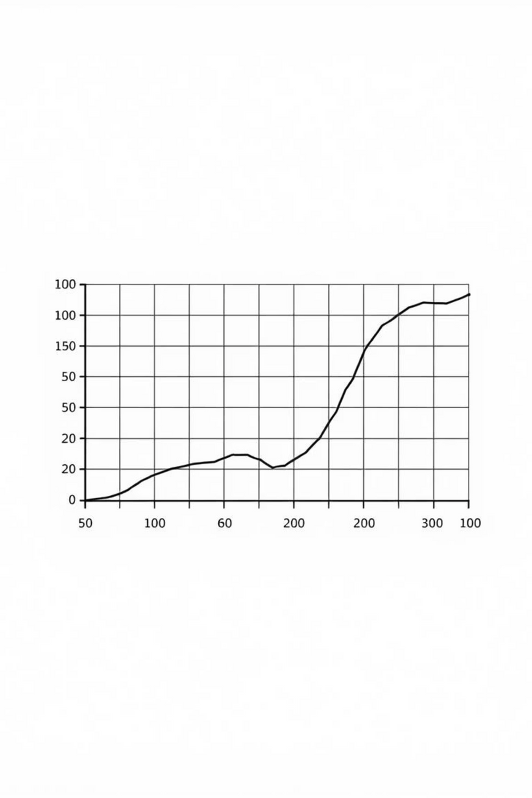



Why RHC Matters: Fairness and Precision
RHC is a powerful tool used when units in the population have different sizes or importance.
Higher Efficiency
Often provides lower variance (more precision) than other PPS methods.
Unbiased Results
The resulting estimates are always unbiased, ensuring fairness.
Simpler Calculation
Easier variance estimation, making it practical for real-world application.
Notes:
12

Slide 18



Unexpected Challenges and Learnings
Non-Uniformity
Efficiency Gains
Broken or unevenly sized grains introduced slight measurement error. RHC accounted for this variance well.
Counting four 10-gram samples took 30 minutes. Estimating the total population would have taken months.
Lesson Learned
Complex statistical methods are highly scalable and applicable to everyday, real-world estimation problems.
Notes:
11

Slide 19

Limitations
Computational Complexity
Requires complex computations for variance estimation, increasing effort and potential for error.
Subgroup Allocation Difficulty
Optimal division of population into subgroups can be challenging and non-intuitive.
High Variance Risk
Potential for increased variance if the initial population division is poorly executed.
Unequal Subgroup Sizes
Performance can degrade significantly if the defined subgroups are highly disparate in size or structure.

Slide 20




Real-World Whispers: Impact & Applications
Socio-Economic Surveys
Used in national surveys (e.g., census follow-ups) to select primary sampling units (like villages or districts) proportional to their population size, ensuring balanced representation.
Forestry & Ecology
Sampling forest plots proportional to area or tree density to estimate timber volume or biodiversity with high precision.
Industrial Quality Control
Selecting samples from batches or production lines proportional to their size to quickly assess overall product quality or defect rates.
Notes:
14

Slide 21
Comparison of Unequal Probability Sampling Methods
n=2 Methods
Durbin: High efficiency, complex
1
2
Brewer: Simple, good variance
n > 2 Methods
PPS (With Replacement): Simple, high variance
3
4
Murthy: Unbiased, complex
Raj: Sequential, efficient
5
6
Sampford: Minimum variance, complex
RHC: Group-based, robust variance
7

Slide 22
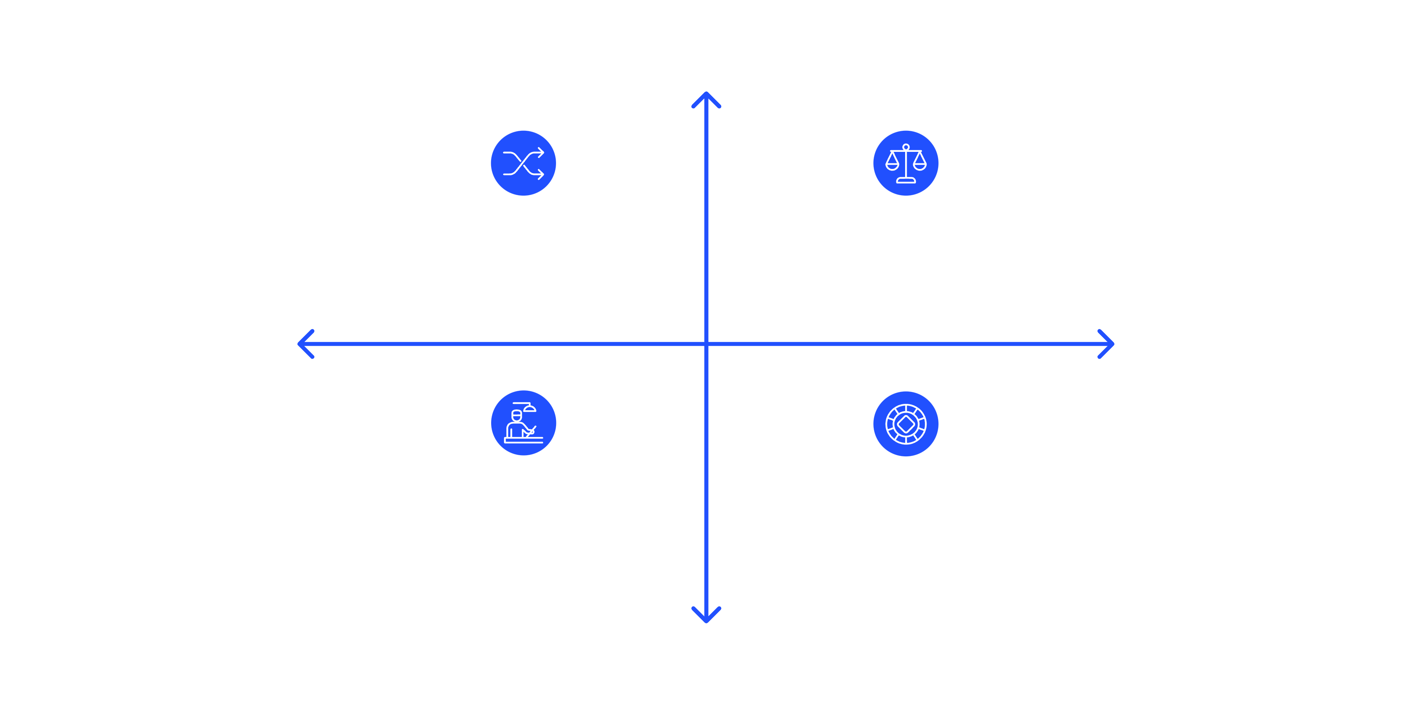
Choosing the Right Method for Your Data
RHC is a powerful technique, but it must be applied judiciously. Evaluate context, data availability, and desired precision.
High Variance Reduction
RHC — High variance reduction, moderate effort
Brewer — High reduction, higher effort
Low Effort to Implement
High Effort to Implement
Murthy — Low reduction, easy to implement
Simple Random — Low reduction, low effort
Low Variance Reduction
The best sampling design minimizes cost for a fixed level of precision or maximizes precision for a fixed budget.

Slide 23


Stratified Cluster Sampling:
Bakhtier Hamim
ID: 12113016

Slide 24
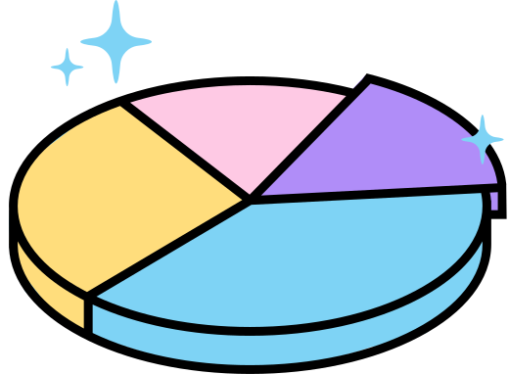
what is Stratified Cluster Sampling?
Stratified Cluster Sampling is a sampling method where the population is first divided into strata (groups) based on certain characteristics, and then within each stratum, the population is further divided into clusters.
After that, some clusters are randomly selected from each stratum, and data is collected from all members (or a sample) within those selected clusters.

Slide 25

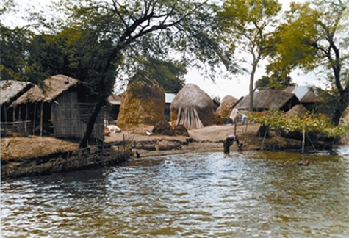
EXAMPLE
A health department wants to know about child nutrition in a country.
Step 1
First, divide the country into urban and rural areas (two strata)

Slide 26
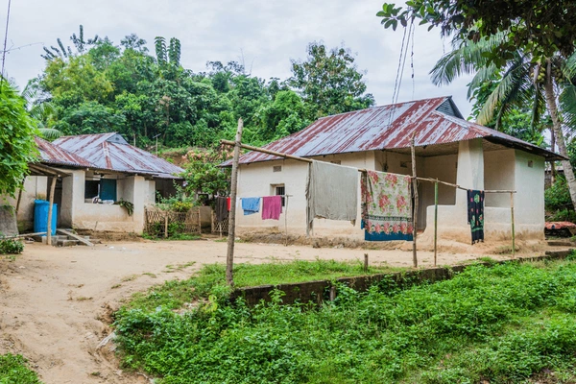
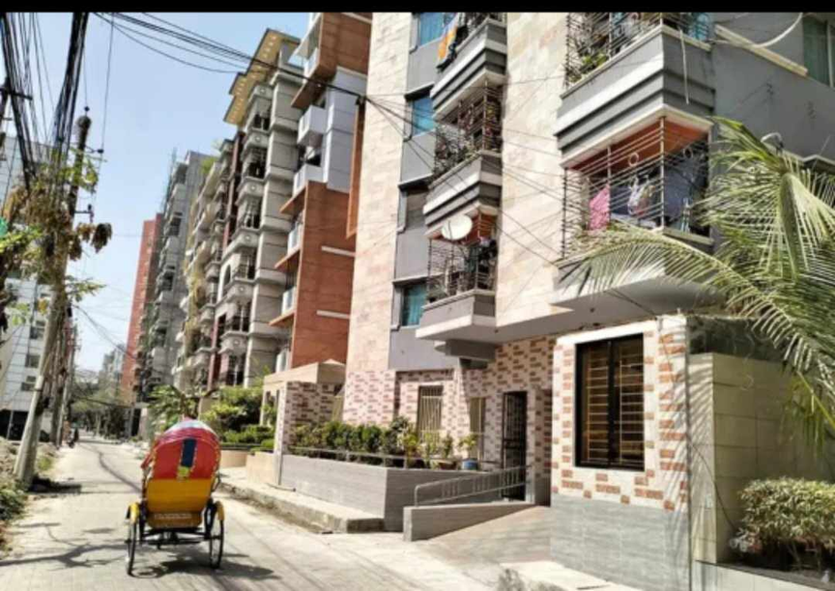
Step 2
In each area, divide households into clusters based on villages or city blocks.

Slide 27

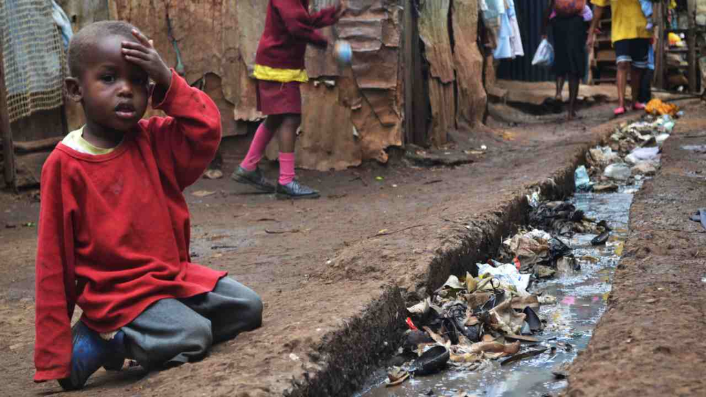
Step 3
Then randomly select some villages/blocks from each area and collect data from all children in those selected clusters.

Slide 28

Multistage Sampling
Multistage sampling is a type of cluster sampling used for large and spread-out populations.
Efficiency
Feasibility
Precision
Saves time and money in large-scale studies.
Enables sampling when a full population list isn't available.
Achieves statistical accuracy with practical field efforts.

Slide 29
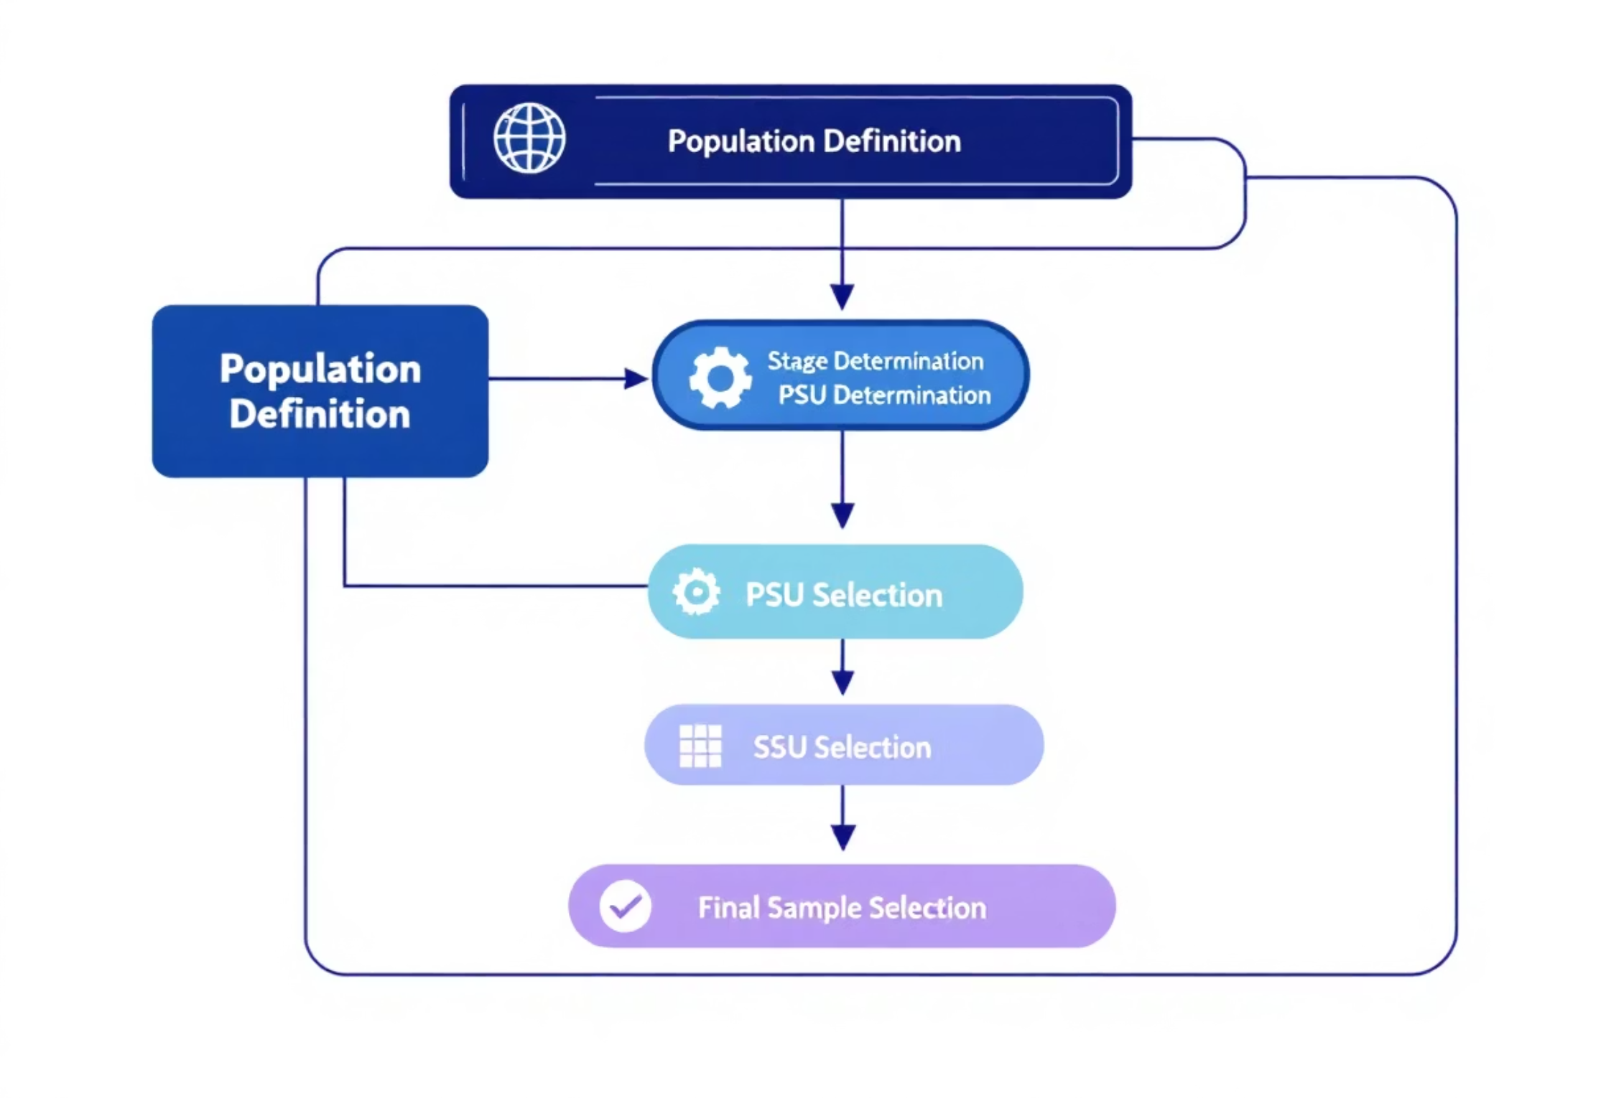
Steps of Multistage Sampling
Multistage sampling breaks down the selection process into smaller, manageable steps, narrowing the scope at each phase until the final sample is reached, typically involving five distinct stages.

Slide 30
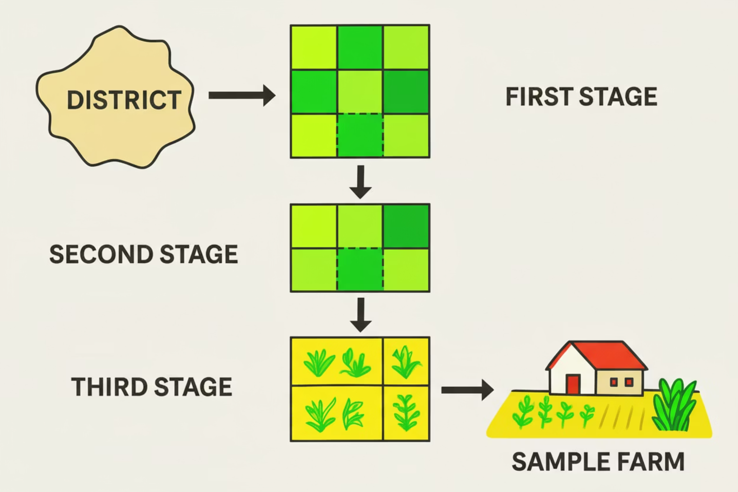
Real life example:
This image shows multistage sampling: first districts are chosen, then villages or blocks, and finally individual farms, making data collection organized and efficient.

Slide 31



Where Multistage Sampling is Appropriate
When the population is large and scattered.
When it’s difficult to list every individual.
The third stage selects specific farms for data collection.
Multistage sampling helps researchers divide a wide population into smaller, more manageable groups for easier data collection.
Instead of listing everyone, researchers can sample groups step by step — saving time and resources.
Large-scale surveys often use multistage sampling to ensure representation from different areas or regions efficiently.

Slide 32
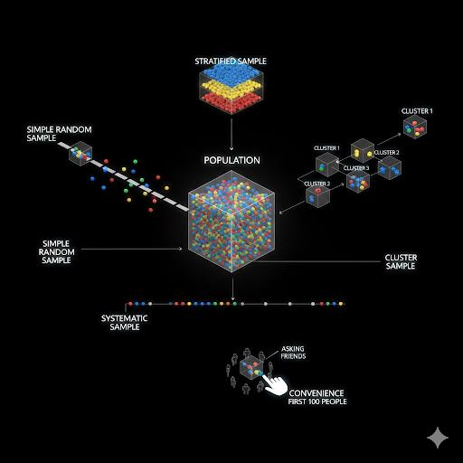
Multiphase vs
Multistage
Sampling
Understanding Concepts, Key Differences, and Real-Life Research Applications
Presented by Barsha Sutradhar
ID-12113026

Slide 33
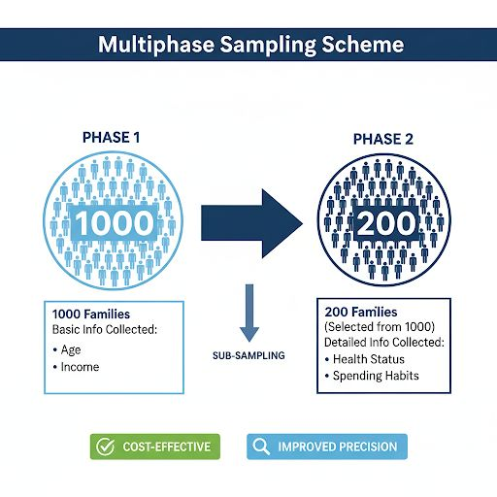



Multiphase Sampling
Multiphase Sampling is a technique where data are collected from the same sampling units in two or more phases.
Each phase provides more detailed information than the previous one.
Key points
Same population units are used in all phases.
Each phase refines or adds new information.
Used when detailed information is costly to collect for all units

Slide 34
Multiphase Sampling
Example :
First Phase : 1000 families → collects basic info (age, home).
Second Phase : 200 families → collect detailed info (health, spending)
Same families → multiple phases of data collection.
Saves Time & Cost
Refined Data Collection
Improved Precision
Initial screening identifies target subsamples for detailed investigation.
Allows tailored, detailed measurement of specific characteristics.
Multiple phases enhance estimate accuracy and statistical reliability.

Slide 35
Multiphase Sampling | Multistage Sampling
Data collected in multiple phases from the same units. | Sampling done step by step from large to small units
Same units in every phase. | Different units at each stage
To collect more detailed into gradually | To simplify selection from large populations
Example : Income → data | Example : Village →Household
Follow-up Surveys | Large scale field surveys
Real Life Example(Multiphase Sampling) :
Bangladesh Bureau of Statistics (BBS) may first collect basic info from all households (Phase 1).
Then select some for detailed health or consumption survey (Phase 2).
Real Life Example(Multistage Sampling) :
National Health Survey :
Select divisions.
Select districts.
Select upazilas.
Select households.
→ Classic Multistage Structure.

Slide 36
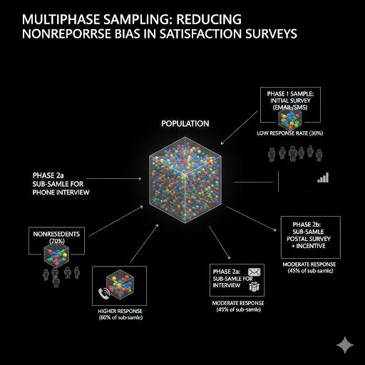
Case Study: Multiphase Sampling in Practice
Reducing Nonresponse Bias in Satisfaction Surveys
Paper: Developing a Two-Phase Post-Stratified Inverse Sampling to Reduce Nonresponse Bias
Author: Mahmood Ahmed Hassan (2019) | Institution: Qatar University
Process
Why Multiphase?
Phase 1: Collected initial response data from all students
Same students studied across phases; objective was refining data quality, not sampling hierarchical levels.
Phase 2: Targeted follow-up with non-respondents
Analyzed response patterns to reduce bias
Result: Significantly reduced nonresponse bias

Slide 37
Choosing the Right Method
The decision between multiphase and multistage sampling depends on your research context:
Study Objective
Are you refining data from same units or sampling hierarchical levels?
Geographic Scope
Is your study localized or nationwide? This shapes whether multistage efficiency matters.
Precision Needs
Do you prioritize estimate accuracy through detailed measurement or representativeness across clusters?

Slide 38
Two-Stage Sampling
A practical approach to surveying large populations efficiently
By-Nazmul Haq
ID-12113033
Notes:
1

Slide 39
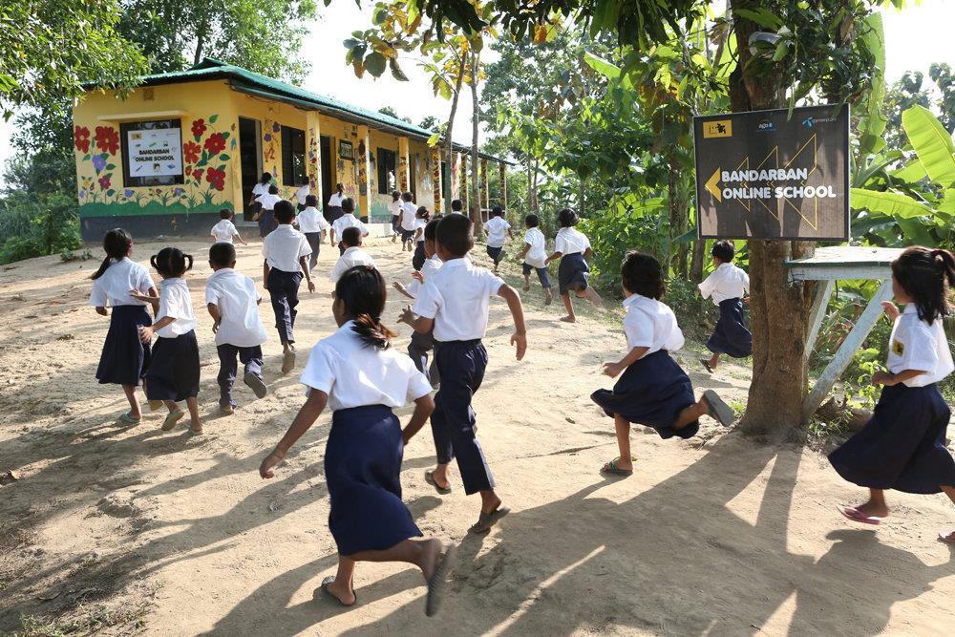
What is Two-Stage Sampling?
Two-stage sampling is a multistage sampling method that selects your sample in two sequential steps. In the first stage, you select clusters or primary units (like villages or schools). In the second stage, you randomly select individual elements from each chosen cluster (like households or students).
This approach dramatically reduces costs and effort when surveying large, geographically dispersed populations—making it ideal for real-world research where resources are limited.
Stage 1
Stage 2
Select clusters randomly
Select individuals from clusters
Result
Representative, cost-effective sample
Notes:
2

Slide 40
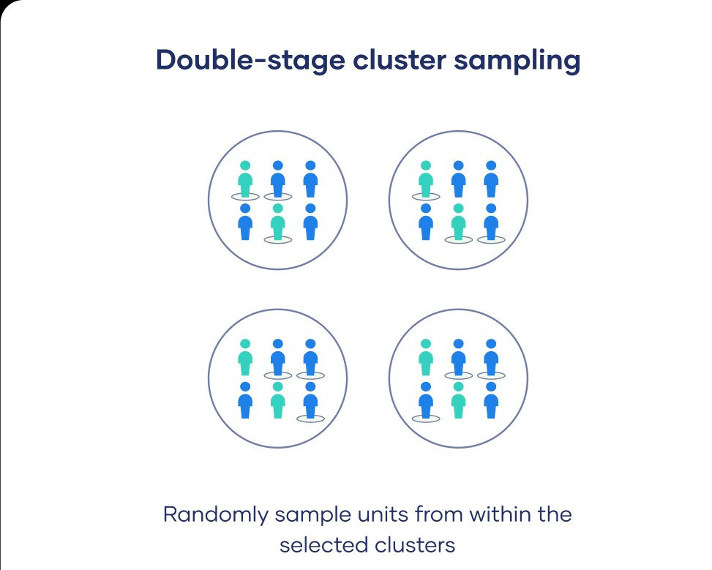

The Two-Stage Process
Step 1: Select Clusters
Randomly draw a sample of primary units (clusters) from your population using a suitable sampling method. These might be geographic areas, institutions, or organizational units.
Step 2: Select Elements
From each selected cluster, randomly sample individual elements (secondary units). This ensures representation within each cluster and maintains randomness throughout.
Notes:
3

Slide 41
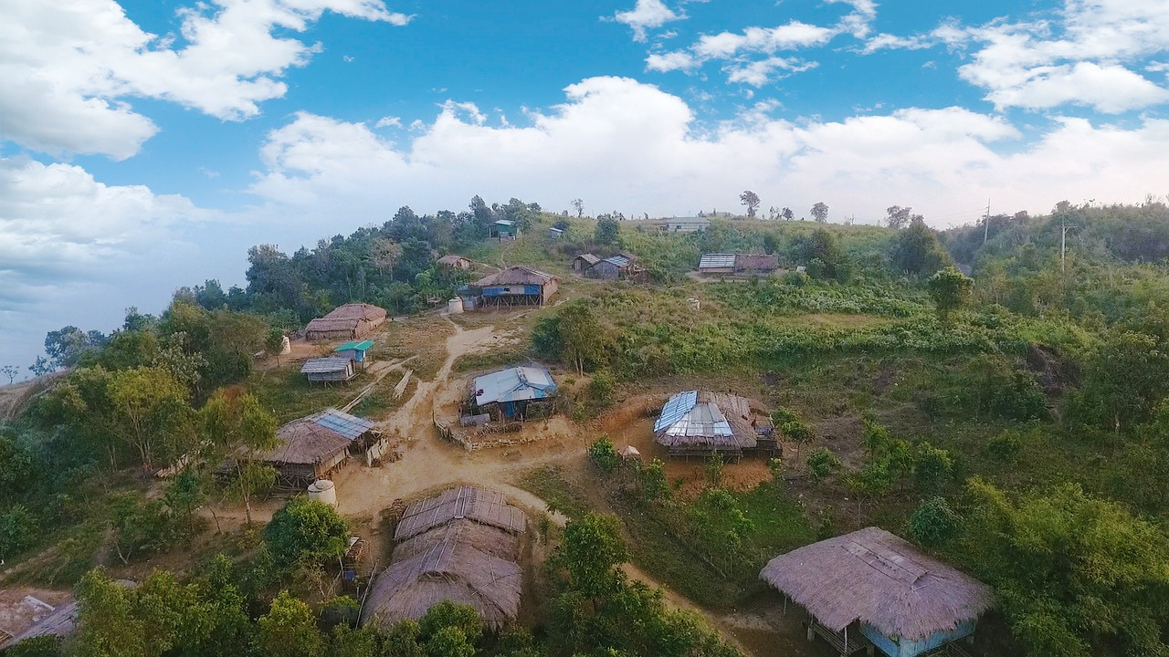

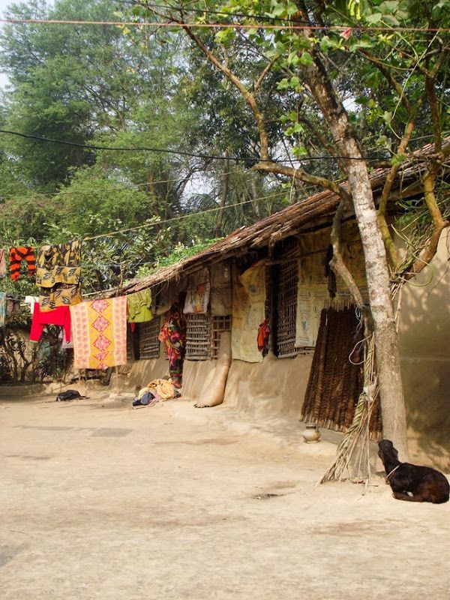
Real-World Example: District Socio-Economic Survey
The Scenario
The Solution
Your research team needs to survey household income and living conditions across an entire district with limited budget and time.
Use two-stage sampling to make it manageable and statistically valid.
1
2
Select Villages
Select Households
Randomly choose 5 villages from the 50 villages in the district. These represent your primary units.
From each of the 5 villages, randomly select 10 households. This gives you 50 total household interviews instead of surveying hundreds.
3
Key Benefit
You gather representative data efficiently—villages are primary units, households are secondary units, and costs drop dramatically.
Notes:
4

Slide 42
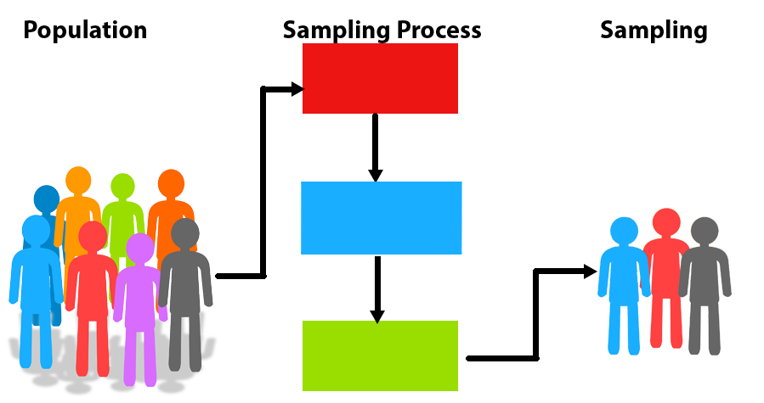
Two-Phase and Two-Stage
Sampling
Understanding Concepts, Key Differences, and Real-Life Applications
Presented by
Bishal Roy
ID : 12113038

Slide 43
What is Two-Phase Sampling?
Two-phase sampling, also called double sampling, involves collecting data in two
successive phases from the same population units to balance cost efficiency with
analytical precision.
Phase 1 : Broad Survey
Phase 2 : Deep Dive
Select a large sample and collect basic information on key variables like demographics, income, or general characteristics.
Select a subsample from Phase 1 respondents and gather detailed, expensive-to-collect data on specialized topics.
.
Practical Example
Phase 1
Phase 2
Survey 1000 families on income , household size and basic demographics
Select a subsample from phase 1 respondents and gather detailed , expensive-to-collect data on specialized topics

Slide 44

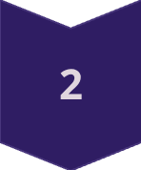
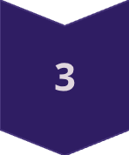
Key Advantages
COST EFFICIENCY
Reduces expenses by collecting detailed data from fewer units while maintaining representativeness through Phase 1.
PRECISION IMPROVEMENT
Enhances estimation accuracy for key variables through targeted Phase 2 measurement of the subsample.
PRACTICAL FEASIBILITY
Optimal when full measurement is expensive, time-consuming, or requires specialized expertise.

Slide 45
Key Differences: Two-Phase vs. Two-Stage Sampling
Understanding these distinctions helps researchers select the appropriate methodology for their study design and objectives
Criterion | Two-Phase Sampling | Two-Stage Sampling
Basis | Two successive data collection phases | Two hierarchical levels of units
Population Focus | Depth of information collection | Structure and geography of population
Units Sample | Same population units in both phases | Different unit types at each stage
Primary Goal | Refine and enhance data quality | Efficiently reach scattered populations
Example | Families surveyed twice for basic then detailed data | Villages selected, then households within villages

Slide 46
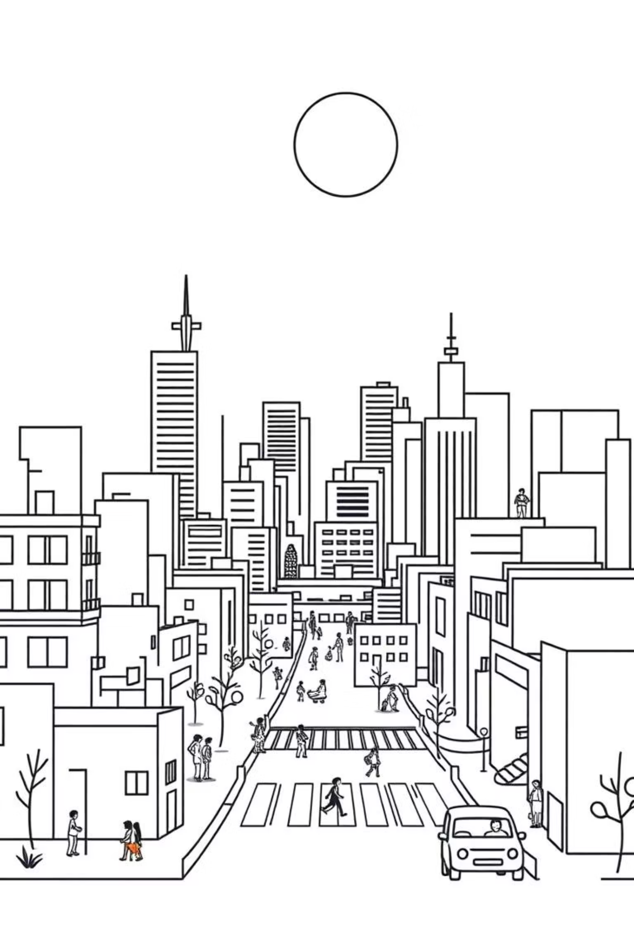
Research Example: Two-Stage Sampling
Prevalence and Factors Associated with Depression among Mothers of School-Going Children in Dhaka City, Bangladesh
Sultana et al., 2021
Study Design
Why Two-Stage?
Natural hierarchical structure: schools as primary units, mothers as secondary units
Stage 1: Randomly selected schools across Dhaka city using geographic stratification
Aimed to capture diversity across multiple geographic areas and school clusters
Stage 2: From each selected school, randomly identified mothers of school-going children for interview
Reduced fieldwork logistics by concentrating data collection within selected schools
Key Insight: Two-stage sampling was appropriate because the population had a clear hierarchical structure (schools containing mothers), and researchers needed representation across diverse geographic clusters in Dhaka.

Slide 47

Research Example: Two-Phase Sampling
Estimation of Caloric Intake and Nutritional Status among Rural Women in India
Reddy et al., 2019
Study Design
Why Two-Phase?
Phase 1: Collected demographic data (age, education, income) from 1,000 rural women
All participants from same population frame—no hierarchical cluster structure
Phase 2: Selected 200 women from Phase 1 for detailed dietary assessment and health measurements
Primary objective was obtaining detailed nutritional data from subsample
Cost-effective approach reduced expensive dietary assessments and lab testing
Key Insight: Two-phase sampling was ideal here because the researchers needed in-depth nutritional information from a carefully selected subsample, not coverage across geographic clusters.

Slide 48
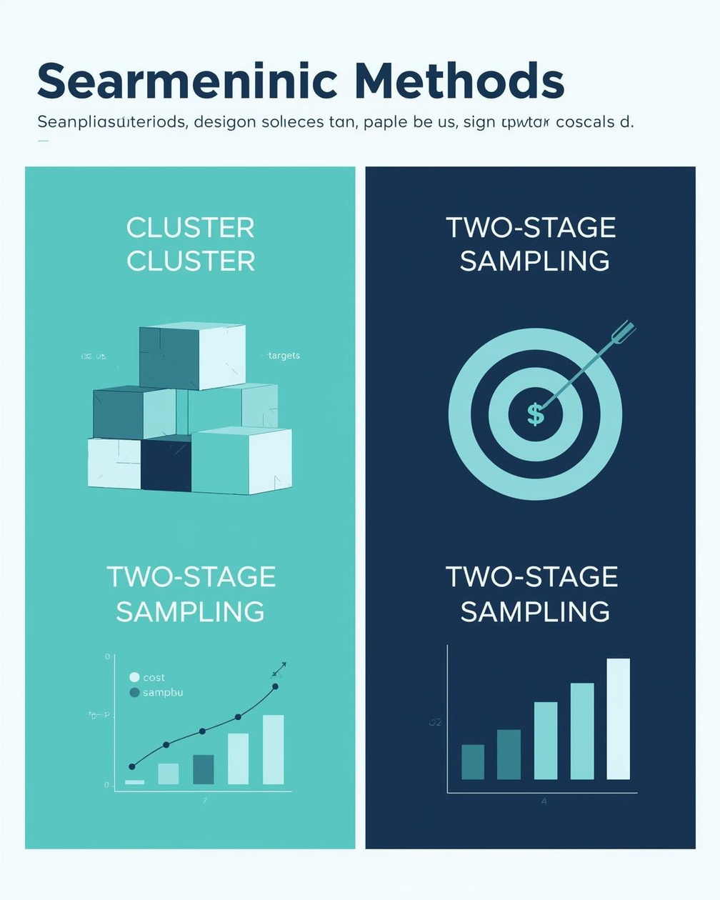


Cluster vs. Two-Stage Sampling
Presented by Minanur Nahar Mojumder
ID:12113041

Slide 49
Cluster Sampling Overview
Two-Stage Sampling Overview
Involves dividing the population into clusters
Each cluster is a mini-representation
Randomly select clusters for sampling
Cost-effective for large populations
Quick data collection method
Good for geographically dispersed populations
Reduces time and resources needed
Combines elements of cluster and simple random sampling
Step 1: Select clusters randomly
Step 2: Randomly select elements within chosen clusters
Provides a more focused approach
Ideal for heterogeneous populations
Effective when comprehensive data is needed
Balances cost and accuracy of results

Slide 50


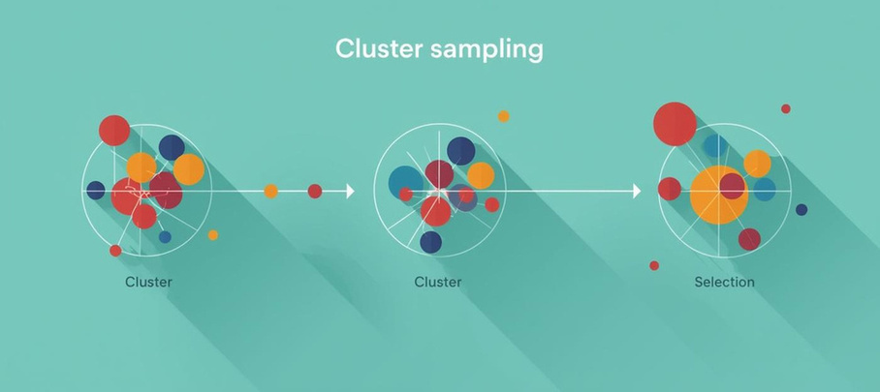
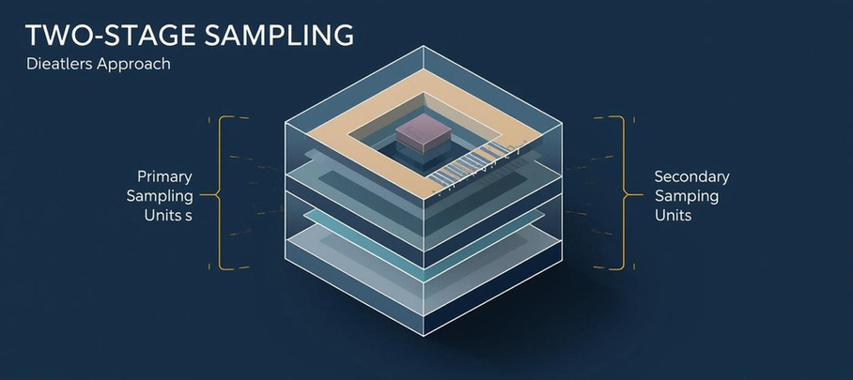
Strategic Comparison: Cluster vs Two-Stage Sampling
Cluster Sampling
Two-Stage Sampling
Simple design with less precision required.
More complex but offers higher precision.

Slide 51
Strategic Comparison of Cluster and Two-Stage Sampling
PROCESS COMPLEXITY
COST IMPLICATIONS
Cluster sampling is a single-step process that simplifies implementation, making it easier to execute. This straightforward approach allows researchers to gather data efficiently, particularly when time and resources are limited.
In terms of cost, cluster sampling is generally more cost-effective as it reduces the need for extensive sampling frames. Conversely, two-stage sampling incurs higher costs due to the layered requirements for sampling frames at both stages, adding complexity.

Slide 52




Strategic Comparison of Sampling Methods
PRECISION
FLEXIBILITY
Cluster sampling tends to have lower precision due to the similarity of units within clusters. This method may introduce bias, as individuals in the same cluster might share characteristics, affecting variability in results.
Two-stage sampling offers greater flexibility, allowing different sampling methods at each stage. This adaptability enhances the design, enabling researchers to optimize for specific conditions and requirements, increasing overall effectiveness.

Slide 53



Advantages of Two-Stage Sampling
FLEXIBILITY
REDUCED WORKLOAD
BALANCED TRADE-OFF
Two-stage sampling provides flexibility by allowing different techniques at each stage, adapting to specific research needs and enhancing the overall effectiveness of data collection.
This method reduces the workload significantly since sampling frames are needed only for selected Primary Sampling Units (PSUs), streamlining the data collection process and saving resources.
It strikes a balanced trade-off between cost and statistical accuracy, making it ideal for complex field studies where precision is critical but resources are limited.

Slide 54
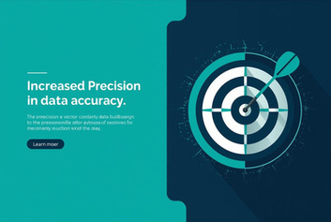
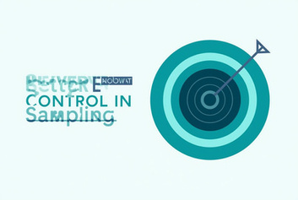
Advantages of Two-Stage Sampling
PRACTICAL FEASIBILITY
STRATEGIC FIT
ENHANCED ADAPTABILITY
Two-stage sampling is particularly advantageous when full sampling frames are unavailable, enabling researchers to gather valuable insights without the need for comprehensive population lists.
This method is often the only viable option for large-scale studies, allowing researchers to navigate complex sampling environments effectively while maintaining data integrity and accuracy.
By allowing different techniques at each stage, two-stage sampling provides a highly adaptable framework that can be tailored to specific research needs, optimizing the data collection process.

Slide 55

“Two-stage sampling is not just a method—it’s a strategy for precision in complexity.”

Slide 56
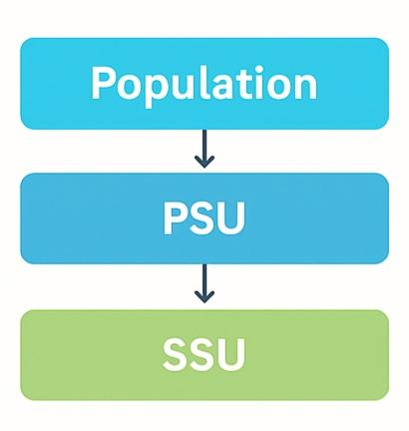
Advantages of Two-Stage Sampling
Flexibility in Selection :
◦ Different selection procedures can be used at different stages.
◦ Allows more control over sampling design.
Stage-wise Frame Requirement :
◦ 1st stage : Only frame of Primary Sampling
Units (PSUs) is needed.
◦ 2nd stage : Frame of Secondary Sampling
Units(SSUs) is required only for selected PSUs.
Population → Villages (PSUs) → Households (SSUs)

Slide 57
Advantages of Two-Stage Sampling over Simple Random Sampling
Reduced Sampling Frame Requirement :
◦ No need for a frame of the entire population.
◦ Only selected PSUs need detailed frames.
Cost-Effective :
◦ Less data collection effort.
◦ Efficient for large populations.
Balanced Precision & Cost :
◦ Choice of number of units in each stage (m) can optimize accuracy vs. cost.

Slide 58

Stratified Two-Stage Sampling
Faria Islam
ID: 12013015

Slide 59
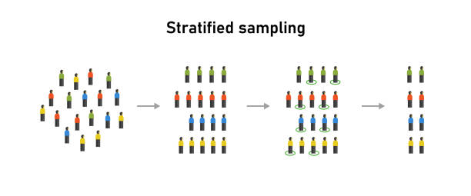
Component of Stratified Two -Stage Sampling-
1. Stratified Sampling
2. Two –Stage Sampling
What is Stratified Sampling?
Stratified sampling divides a population into homogeneous subgroups called strata—groups that share similar characteristics. Random samples are then drawn independently from each stratum, ensuring that all subgroups are represented in the final sample. This approach is particularly effective when the population has distinct groups that differ significantly from one another.
Population Divided
Independent Sampling
Random samples from each stratum
Split into homogeneous strata
Full Representation
All subgroups included in sample

Slide 60
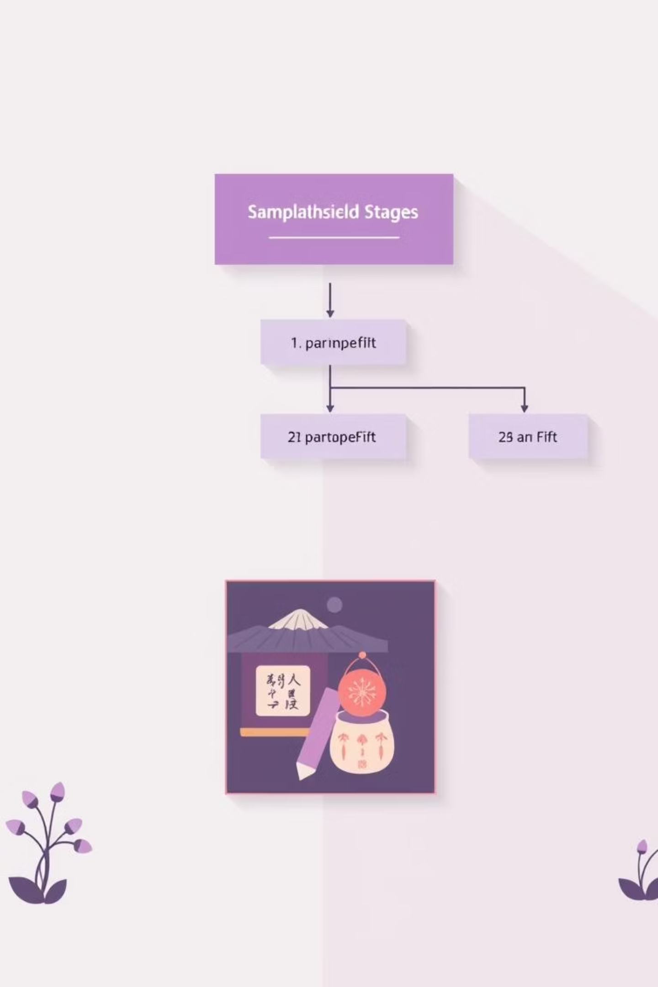

What is Two-Stage Sampling?
In two-stage sampling, samples are selected in two steps. First, larger groups or clusters are randomly chosen from each stratum. Then, individuals are randomly selected from within these clusters. This method is cost-effective, practical, and ensures that the sample represents the entire population without surveying everyone.
Stage One
Select primary units (clusters or groups)
Stage Two
Select secondary units within chosen primary units

Slide 61
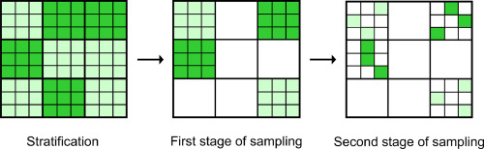
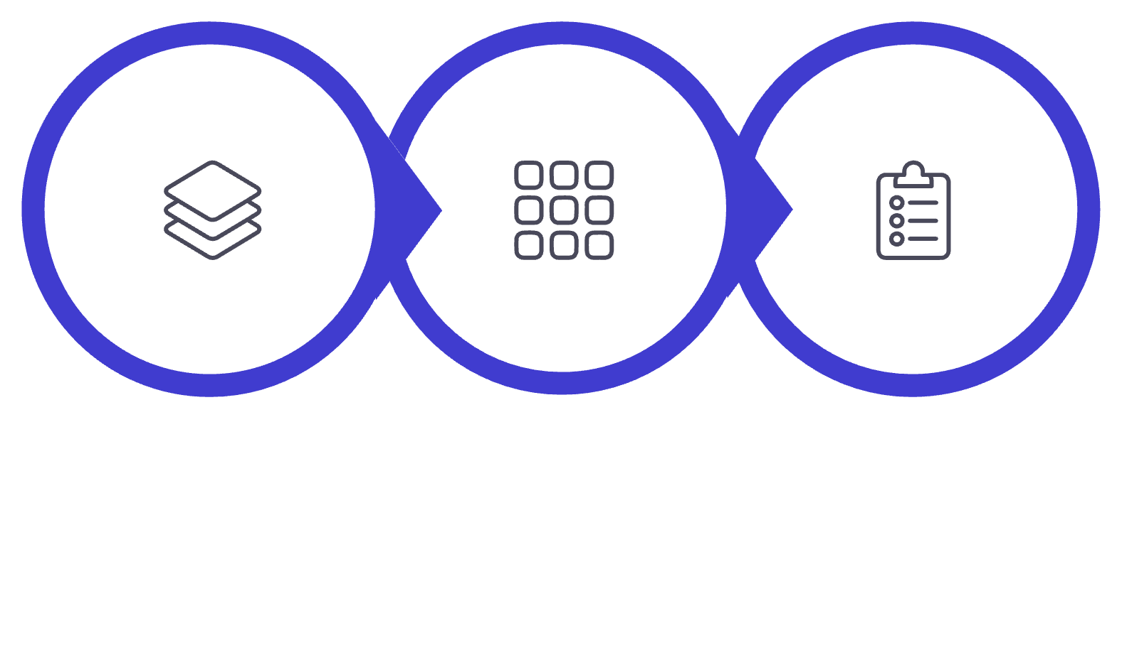
Stratified Two-Stage Sampling Explained
Stratified Two-Stage Sampling is a hybrid sampling method that combines stratified sampling and two-stage sampling. First, the population is divided into strata based on specific characteristics to ensure representation. Then, within each stratum, sampling is carried out in two stages: clusters are randomly selected in the first stage, and individuals are randomly chosen from these clusters in the second stage
Stratify Population
Select Primary Units
Select Secondary Units

Slide 62



Example: School Survey on Academic Performance
Population
(All student in the city)
Stratification
Objective: To study the academic performance of students in a city’s high schools.
01
Stratified Sampling-
Public school
Private
School
The population is all students in the city.
Divide students into strata based on school type (e.g., public vs. private).
This ensures representation from both types of schools.
02
Selected Primary units
(Selected Schools)
Select Primary Units- (Clusters)
• Randomly select clusters from each stratum .
• Example : Select 5 schools from each school type (Public/ Private)
03
Select Secondary Units- (Individuals)
Selected Secondary Units
(Selected Students)
• Randomly select individuals from each chosen cluster .
• Example : Pick 20 students from each selected school .
04
Analyze Results
The survey sample includes students from all types of schools (stratified).
Within each school, not all students are surveyed, only a selected number (two-stage),
making it cost-effective and representative.

Slide 63

Advantages of Stratified Two-Stage Sampling
This methodology delivers substantial benefits for researchers and organizations:
Complete Representation
Reduced Cost
By selecting samples from all strata and clusters, this method ensures that the final sample accurately reflects the diversity and characteristics of the entire population.
Instead of surveying every individual, only selected clusters and units are sampled, which saves time, money, and other resources while still collecting meaningful data.
Improved Accuracy
Practical Flexibility
Careful selection of clusters and individuals within clusters helps to reduce sampling error, providing more reliable and precise results.
Two-stage sampling can be combined with other sampling methods (like stratified sampling) and adapted to different population structures, making it highly practical for various survey scenarios.

